Slide 1

Automated Chest X-ray Report Generation Using Vision-Language Models
Case study
Rakesh Nagaragatta Jayanna Supervisor: Prof. Mehrdad Jalali

Slide 2
🩺 Introduction
Chest X-rays are among the most widely used diagnostic tools for detecting thoracic and cardiac conditions.
Manual interpretation and report writing are time-consuming, prone to human error, and often inconsistent across radiologists.
Recent advancements in deep learning and transformer-based models have opened new possibilities for automating clinical tasks.
This study explores the use of Vision-Language Models (ViT + GPT-2) to automatically generate radiology reports from chest X-ray images.
The goal is to enhance diagnostic efficiency, consistency, and reduce the workload on radiologists in high-volume clinical environments.

Slide 3
Literature Review
Paper | Key Insights
Clinical Context-aware Radiology Report Generation (2024) | Contextual patient data integration improves BLEU by up to 30% and reduces irrelevant findings.
Deep learning approaches to automatic radiology report generation: A systematic review (2023) | Transformers outperform RNN/CNNs in global context capture; over 50 models reviewed for interpretability and consistency.
Radiology Report Generation using Full Transformer Architecture (2023) | Full-attention GPT-2 decoder reduces n-gram errors by 25% and improves linguistic fluency.
METransformer: Radiology Report Generation by Transformer With Multiple Learnable Expert Tokens (2024) | Expert tokens enhance pathology coverage and reduce diagnostic oversights by 12%.
Radiology Report Generation Using Transformers Conditioned with Non-imaging Data (2023) | Multimodal inputs (imaging + demographics) increase complex pathology accuracy by 15%.
Automated radiology report generation using conditioned transformers (2021) | Clinical conditioning improves BLEU and METEOR by ~20%, emphasizing domain-specific training.
Multi-modal transformer architecture for medical image analysis and automated report generation (2024) | Cross-attention strategy improves report completeness and correlation between text and image content.

Slide 4
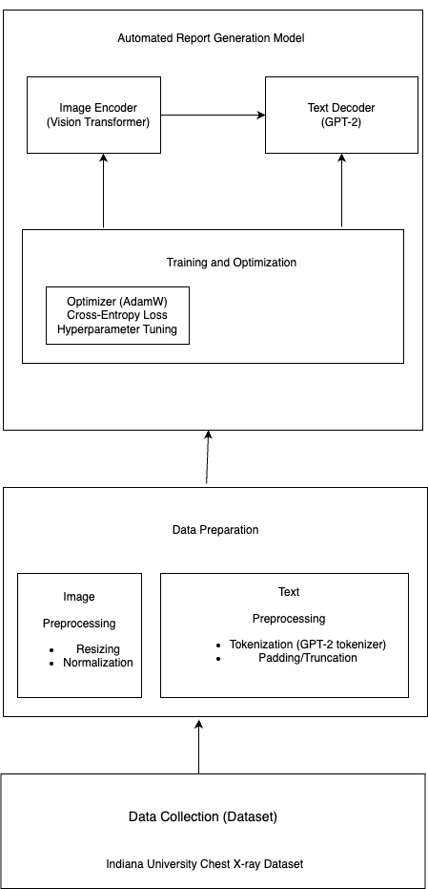
Methodology
1. Data Collection Indiana University Chest X-ray dataset
2. Data Preprocessing Image Preprocessing Text Preprocessing
3. Model Architecture
4. Training and Optimization

Slide 5
Data Collection
1. Dataset – Indiana University Chest X-ray Collection
The dataset comprises 7,470 chest X-ray images, each annotated with radiology reports written by professional clinicians.
Each report contains multiple sections (e.g., findings, impressions); impressions were selected as the target text for generation due to their concise diagnostic nature.
Only frontal view (PA or AP) images were used to maintain consistency and reduce complexity from mixed image types.
The dataset is publicly available and widely used for benchmarking automated report generation models.
🔗 Source: Kaggle – Chest X-rays (Indiana University)

Slide 6
Data Preprocessing
Image Preprocessing
All chest X-ray images were resized to 224 × 224 pixels to conform with the input size requirement of the Vision Transformer (ViT).
Pixel intensities were normalized using mean and standard deviation values from ImageNet to leverage pretrained ViT weights.
Images were converted to RGB format to match ViT expectations, even though they are originally grayscale.
Text Preprocessing
The impression section of each radiology report was extracted and cleaned (removing extra whitespaces, line breaks).
Text was tokenized using the GPT-2 tokenizer, converting natural language into token IDs suitable for model training.
All token sequences were padded or truncated to a uniform length of 128 tokens to ensure consistent input sizes for batch processing.
The special tokens such as <eos> and <pad> were used to mark sentence ends and handle variable-length inputs.

Slide 7
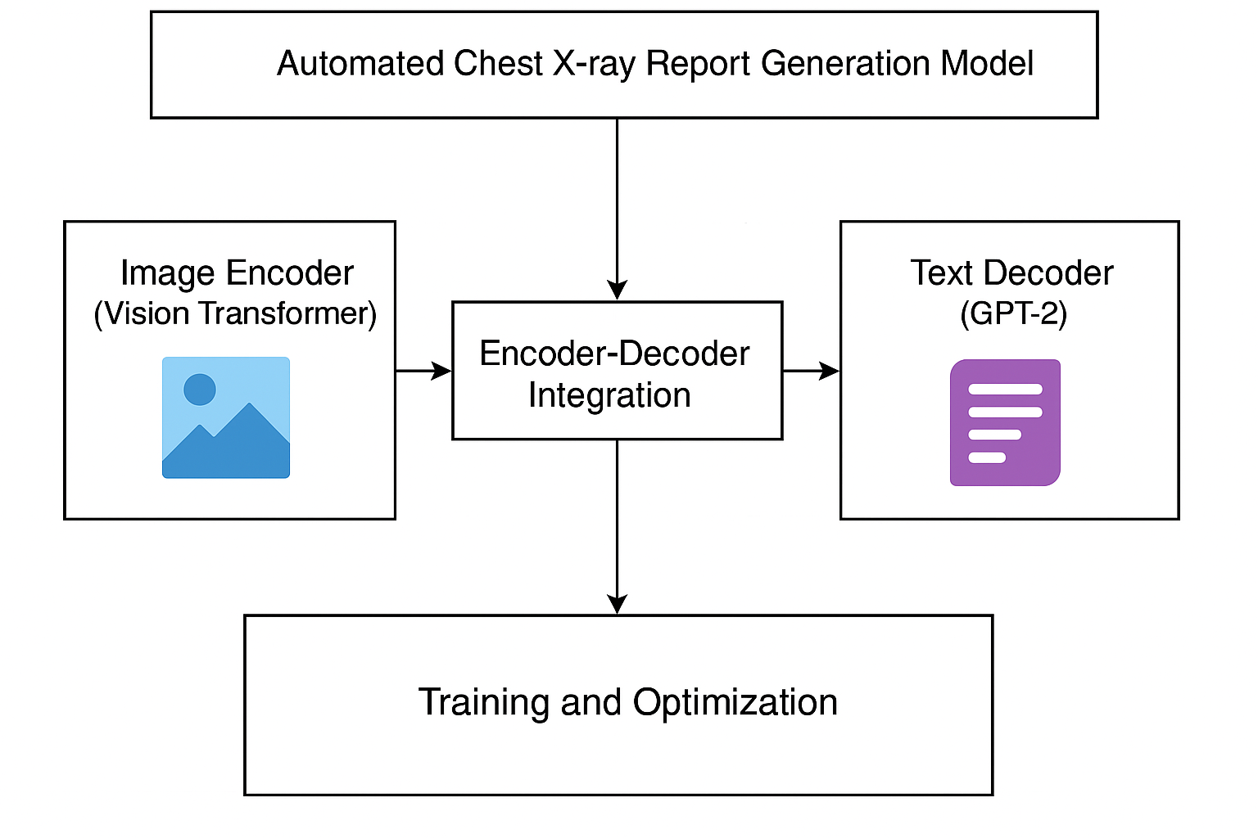
Model Architecture

Slide 8
Model Architecture
The automated chest X-ray report generation system is built using a Vision-Language Transformer Architecture, which combines two powerful pretrained models: a Vision Transformer (ViT) as the image encoder and GPT-2 as the text decoder
Image Encoder – Vision Transformer (ViT)
The ViT model processes input chest X-ray images by dividing them into patches and embedding each patch into a sequence.
These embedded patches are passed through self-attention layers to extract rich, global visual features from the image.
The encoder outputs a sequence of hidden states that represent the image’s semantic content.
Pretrained weights from ViT-Base (google/vit-base-patch16-224-in21k) were used to leverage visual knowledge from ImageNet.
Text Decoder – GPT-2
The GPT-2 model is used to generate the radiology report impression, conditioned on the image features from the encoder.
GPT-2 is a transformer-based auto-regressive decoder trained to predict the next word in a sentence.
It takes the encoded image representation and starts generating one token at a time using causal self-attention.
GPT-2 ensures grammatical fluency, coherent sentence flow, and aligns the text with medical style.

Slide 9
Model Architecture
Encoder-Decoder Integration
The architecture is built using VisionEncoderDecoderModel from Hugging Face Transformers, which seamlessly connects ViT and GPT-2.
During training, the model learns to map image features to medical text, optimizing the Cross-Entropy Loss between predicted tokens and ground truth reports.
Special tokens like <eos> (end of sentence) and padding tokens are handled explicitly using GPT-2's tokenizer configuration.

Slide 10
Training and Optimization
The model training process was designed to optimize the performance of the VisionEncoderDecoderModel, combining a Vision Transformer (ViT) as the encoder and GPT-2 as the decoder. The goal was to minimize the difference between the generated and actual radiology reports through iterative learning.
Training Configuration
Epochs: 20 full passes through the dataset were performed to allow the model sufficient opportunity to learn image-text mappings.
Batch Size: 4 images per batch, suitable for GPU memory constraints during training.
Device: The model was trained using CUDA-enabled GPUs, which significantly accelerated training time.
Learning Rate: Set to 5e-5, enabling stable gradient updates and convergence.
Optimizer: AdamW was used, which combines Adam's adaptive learning rate with weight decay for better regularization.
Loss Function: CrossEntropyLoss, ignoring the padded tokens in the target sequence to avoid bias during optimization.
Loss Computation
During training, the model predicts a sequence of tokens (text report) based on visual inputs.
The Cross-Entropy Loss calculates how far off these predictions are from the ground truth impressions.
Padding tokens are ignored using ignore_index=pad_token_id, ensuring the loss focuses only on meaningful parts of the report.

Slide 11
Optimization Strategy
Teacher Forcing was implicitly used during training — the model receives the correct previous token to predict the next token.
No gradient accumulation or early stopping was applied in this version, though these could be added in future iterations.
Model performance was monitored across epochs using validation BLEU, ROUGE, and METEOR scores.

Slide 12
Results and Discussion
1. Quantitative Results
To evaluate the quality and accuracy of the generated radiology reports, three widely-used natural language generation (NLG) metrics were used:
Metric | Score | Interpretation
BLEU | 0.51 | Indicates moderate fluency and n-gram overlap with reference reports. The model captures phrase-level similarities.
ROUGE-1 | 0.55 | Suggests good recall of important keywords and clinical terms used in actual reports.
METEOR | 0.53 | Reflects solid semantic alignment, handling synonyms and word order well. Indicates clinically meaningful text generation.

Slide 13
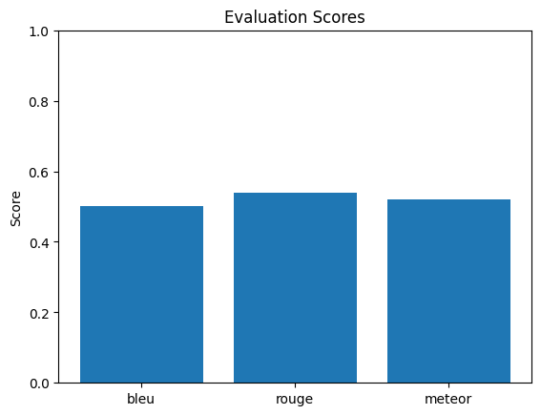
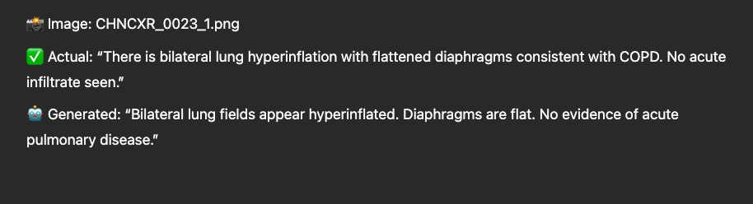
Qualitative Analysis

Slide 14
Observations:
Model captures key clinical findings well (e.g., “hyperinflation”, “no acute”).
Sentence structure is fluent and similar to professional language.
Occasionally, fine details are missed, or statements are generalized.
💡 3. Key Insights
The model is effective in generating fluent summaries that reflect core radiological observations.
While metric scores are not state-of-the-art, they are reasonable for a ViT-GPT2 baseline model.
Performance can improve with larger datasets, clinical LLMs, or multimodal inputs (e.g., history, vitals).

Slide 15
Conclusion and Future Work
This project demonstrated the effectiveness of a Vision-Language Transformer architecture, combining a Vision Transformer (ViT) and GPT-2, for automated chest X-ray report generation. Trained on the Indiana University dataset, the model achieved promising results with BLEU (0.51), ROUGE-1 (0.55), and METEOR (0.53) scores, indicating fluent and semantically relevant text generation.
The system successfully learned to produce concise clinical impressions from medical images, showing potential to assist radiologists by reducing workload and improving reporting consistency.
Future enhancements include:
Integrating clinical language models (e.g., BioGPT) for improved medical accuracy
Using multimodal data (e.g., patient history) to enhance context
Expanding to larger datasets like MIMIC-CXR for better generalization
Adding factual verification to reduce hallucinations
Exploring deployment options for real-time clinical use

Slide 16

Thank You

